Slide 1


Bank of Baroda Hackathon - 2022
Technology Partner
Your Team Name : ZerOne
Your team bio :S.Sriram
Date :19.08.22

Slide 2
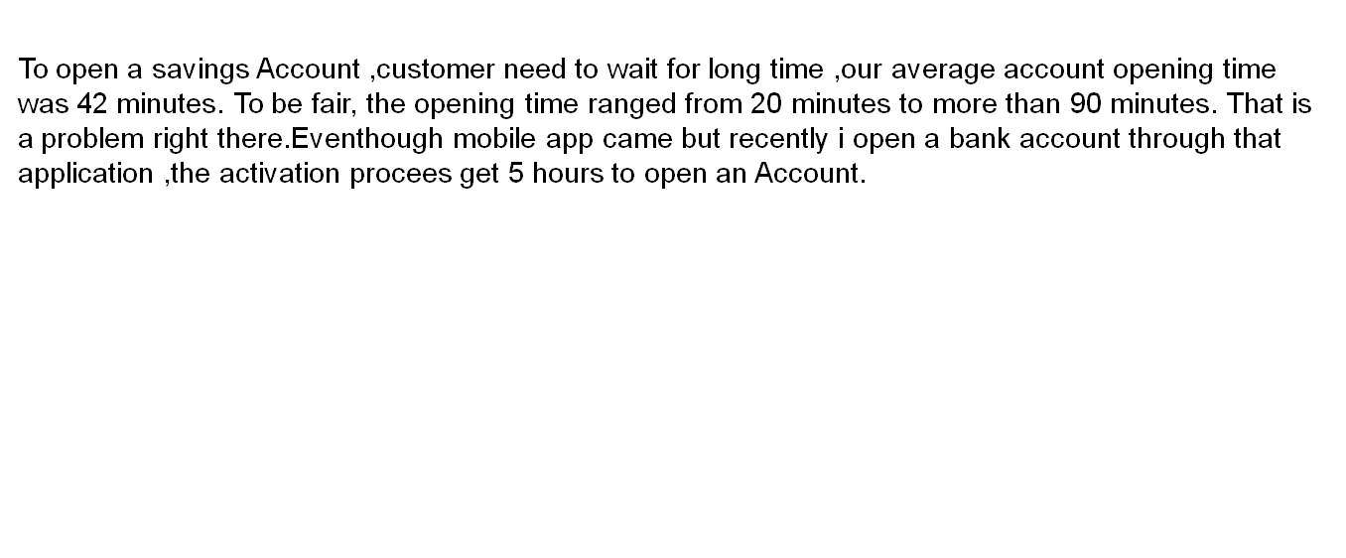
Problem Statement – Time Delay to Open a Saving Account for Customer

Slide 3
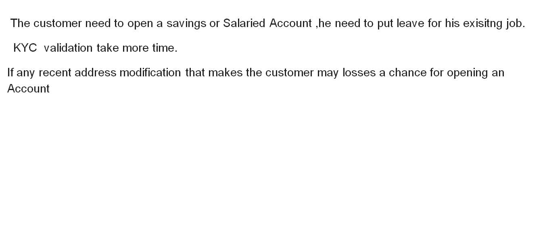

Slide 4
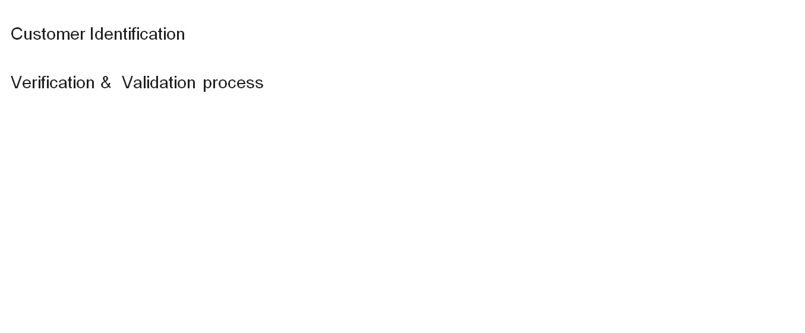
Pre-Requisite

Slide 6
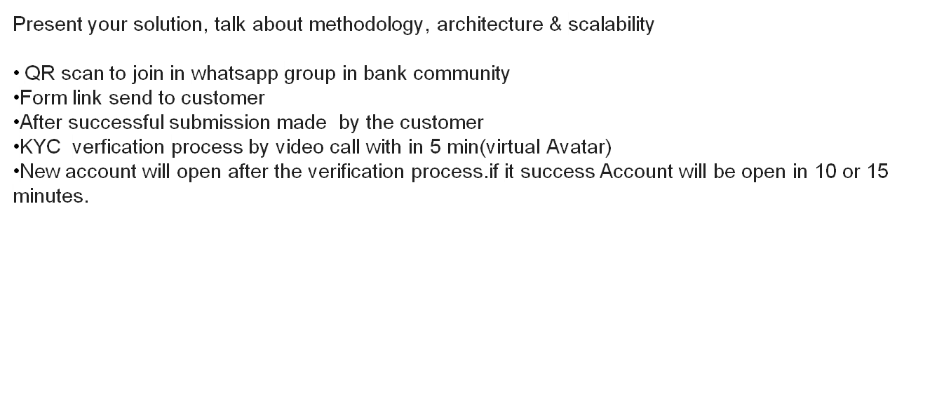
Methodology

Slide 7
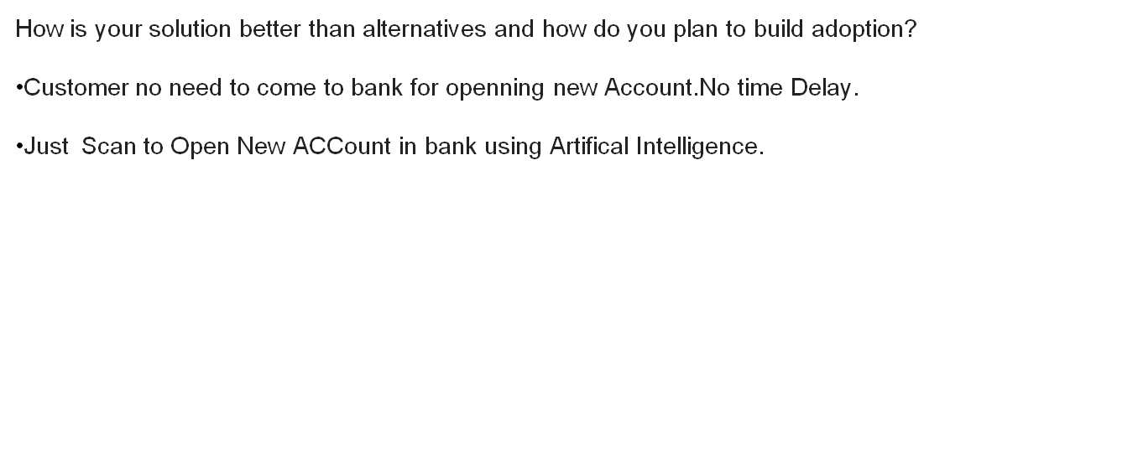
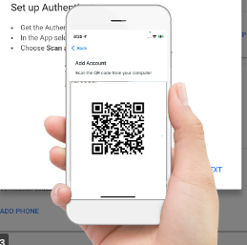

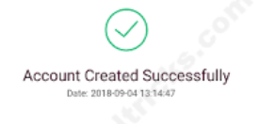

Slide 8
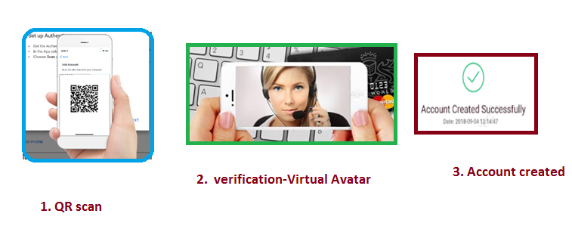

Slide 9
Thank You
S.Sriram

